Slide 1
The Data Delusion
NEIL LAWRENCE
UNIVERSITY OF SHEFFIELD
@lawrennd
Notes:
Challenges
Introduce self
Alphago impressive but requires heavy compute.
More games of go than any human
And yet still Lee managed to win a match.

Slide 2
GLOBAL INFORMATION STORAGE CAPACITY
IN OPTIMALLY COMPRESSED BYTES
SVMs
dominate
NIPS
ConvNets
Developed
Notes:
Superhuman performances are being driven by ML
Vision, Speech, Translation
Lots of process, but driven by availability of data.
Methodologies have not progressed a great deal since late 1990s

Slide 3
Notes:
Historical Analogy
Thomas Newcomen South West England
1712 Steam Engine

Slide 4
Coal
Google
Facebook
Amazon
Tin
Startups

Slide 5
Notes:
People and entire fields are passed by.

Slide 6
Notes:
James Watt Separate Condensor 1760s

Slide 7
Outline of the DeepFace architecture. A front-end of a single convolution-pooling-convolution filtering on the rectified input, followed by three locally-connected layers and two fully-connected layers. Color illustrates feature maps produced at each layer. The net includes more than 120 million parameters, where more than 95% come from the local and fully connected layers.
Source: DeepFace
Notes:
Modern Inference Engine
120 million parameters, 1 billion images, near human performance

Slide 8











$\text{g}\left(x\right)$
${\text{f}}_{1}(x)$
${\text{f}}_{2}(∙)$
${\text{f}}_{3}(∙)$
${\text{f}}_{4}(∙)$
${\text{f}}_{5}(∙)$
${\text{f}}_{6}(∙)$
${\text{f}}_{7}(∙)$
${\text{f}}_{8}(∙)$
${\text{f}}_{9}(∙)$
$\text{g}\left(x\right)={\text{f}}_{9}({\text{f}}_{8}({\text{f}}_{7}({\text{f}}_{6}(⋯))))$

Slide 9
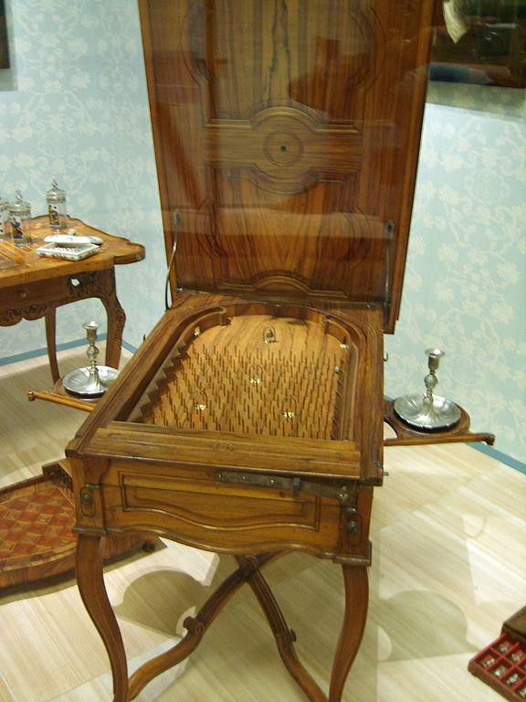
Notes:
Internal structure of the machine like layers of pins
Initial state of machine.
Moving pins around to fix

Slide 10

$f_{9}\left(\text{h}\right)=\left[\begin{matrix}φ\left(\sum_{i}{w_{1i}h_{i}}\right) \\ \begin{aligned}φ\left(\sum_{i}{w_{2i}h_{i}}\right) \\ ⋮\end{aligned} \\ φ\left(\sum_{i}{w_{ki}h_{i}}\right)\end{matrix}\right]$

Slide 11


$f_{9}\left(\text{h}\right)=\text{ϕ}\left(\text{Wh}\right)$
$$\text{W}∈ℜ^{k_{8}×k_{9}}$$

Slide 12





$x$
$$\text{ϕ}\left({\text{W}}_{1}x_{1}\right)$$
$$\text{ϕ}\left({\text{W}}_{2}h_{1}\right)$$
$$\text{ϕ}\left({\text{W}}_{3}h_{2}\right)$$
$$y$$
Yes
No

Slide 13
$x$
$$\text{ϕ}\left({\text{W}}_{1}x_{1}\right)$$
$$\text{ϕ}\left({\text{W}}_{2}h_{1}\right)$$
$$\text{ϕ}\left({\text{W}}_{3}h_{2}\right)$$
$$y$$
Yes
No

Slide 14
B
A
Notes:
All possible paths!

Slide 15



$g(x)$
$$\int{g\left(x\right)p\left(x\right)dx}$$
$$\frac{dg(x)}{dx}$$

Slide 16
Gaussian Processes

Slide 17

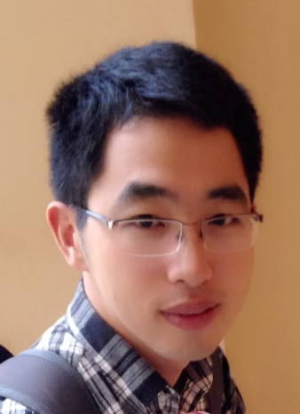

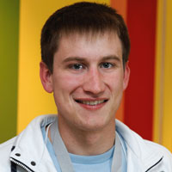
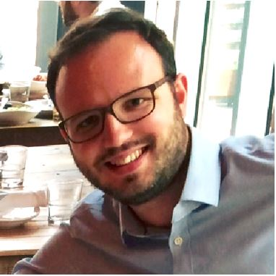
Health
Complex system
Scarce data
Different modalities
Poor understanding of mechanism
Large scale
genotype
environment
epigenotype
State of health
clinical tests
gene expression
Organ states
treatment
clinical notes
Cell states
survival analysis
PLoS Comp Bio, Nature Methods
biopsy
X-ray
biopsy
X-ray

Slide 18


Slide 19
Coal
Google
Facebook
Amazon
Data
Infrastructure
Railways
Tin
Startups

Slide 20
User
Data
User
Data
User
Data
Data
data
trust
ML
User
Data
ML
User
Data
User
Data
User
Data

Slide 21



Slide 22
Thank you
Neil Lawrence
http://inverseprobability.com
@lawrennd
Notes:
Thank you.

