Slide 1
The Rise of the Algorithm
Neil Lawrence
Amazon Research Cambridge
University of Sheffield
@lawrennd
Notes:
Challenges
Introduce self
Alphago impressive but requires heavy compute.
More games of go than any human
And yet still Lee managed to win a match.

Slide 2
Notes:
Reminder of the AlphaGo achievement, introduce the challenge and how it was solved. 30 million games.

Slide 3
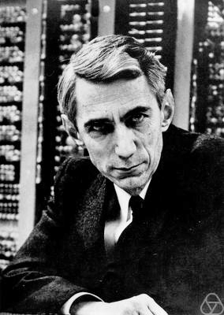
~10 gigaflops
10
~1 gigabit per second
~1000 teraflops?
$${10}^{13}$$
~100 bits per second?
Notes:
Embodiment factors: the fundamental differences between a human and a computer

Slide 4
Notes:
Human brain like an F1 car, but an F1 car with bicycle wheels. We have a locked in intelligence.

Slide 5
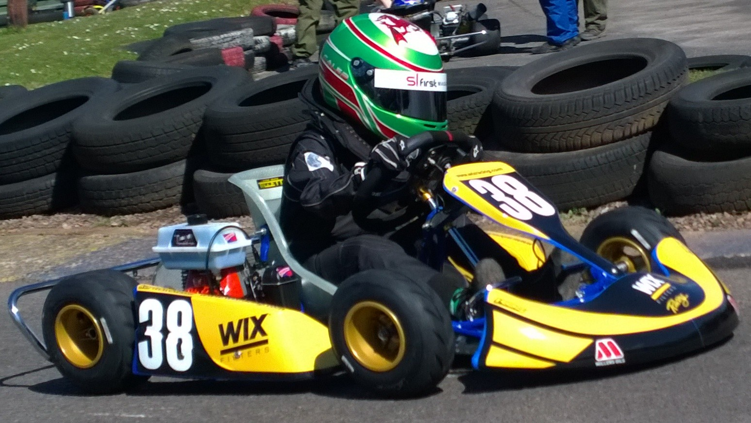
Notes:
Computers are better balanced, they are lower powered, but because they have high bandwidth communication they can deploy all their power on the track.

Slide 6
Notes:
Peabody Library, laid out for human access

Slide 7
Notes:
Large amount of digital data accessible to all

Slide 8
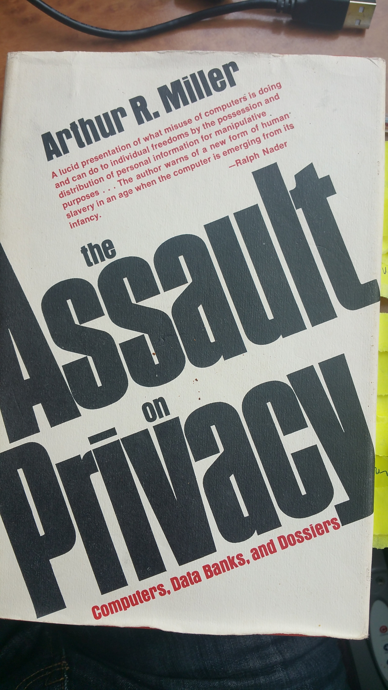
Notes:
1970 publication by Arthur Miller: The Assault on Privacy

Slide 9
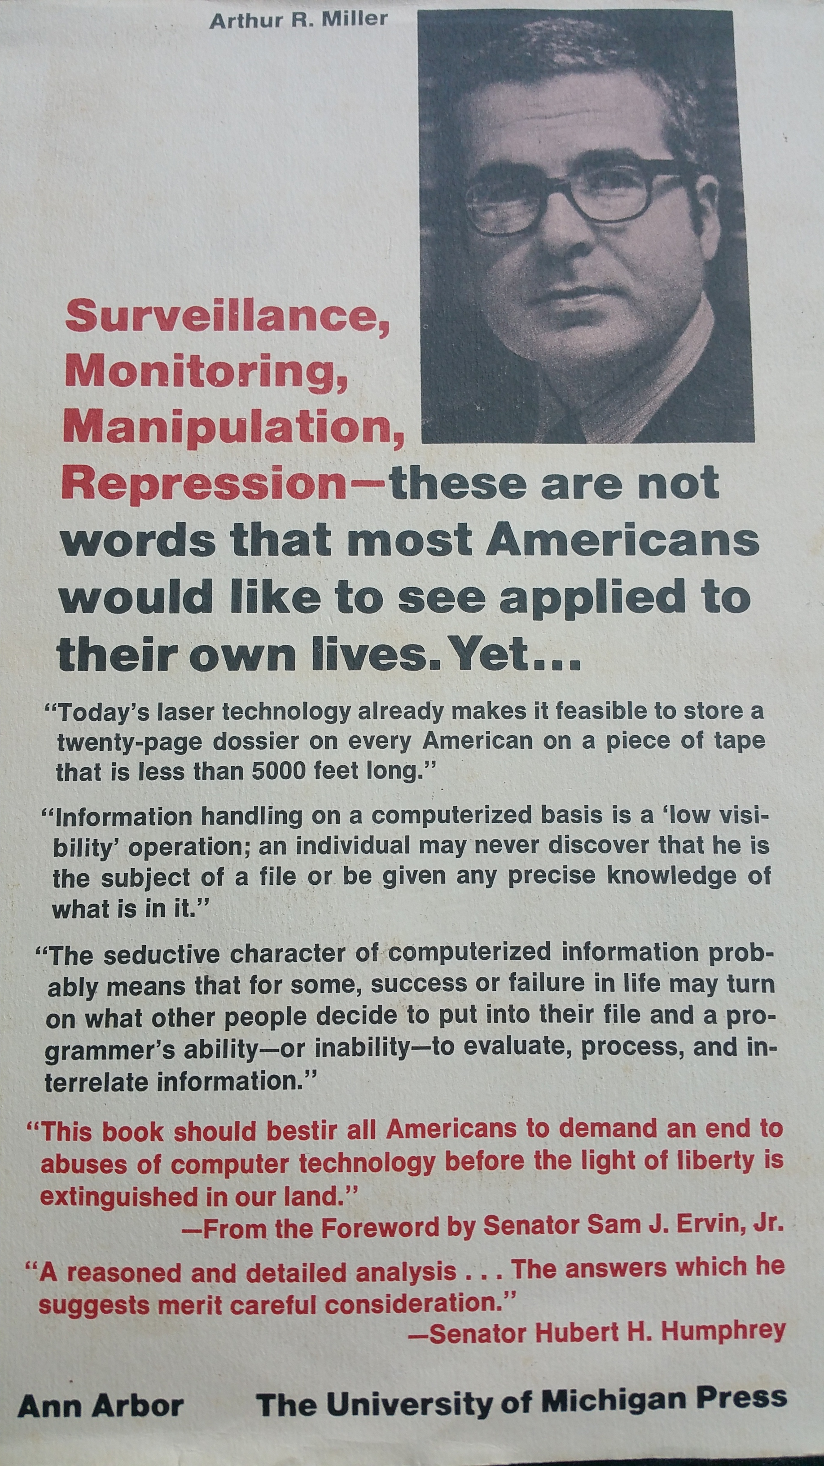
Notes:
All be seen before.

Slide 10
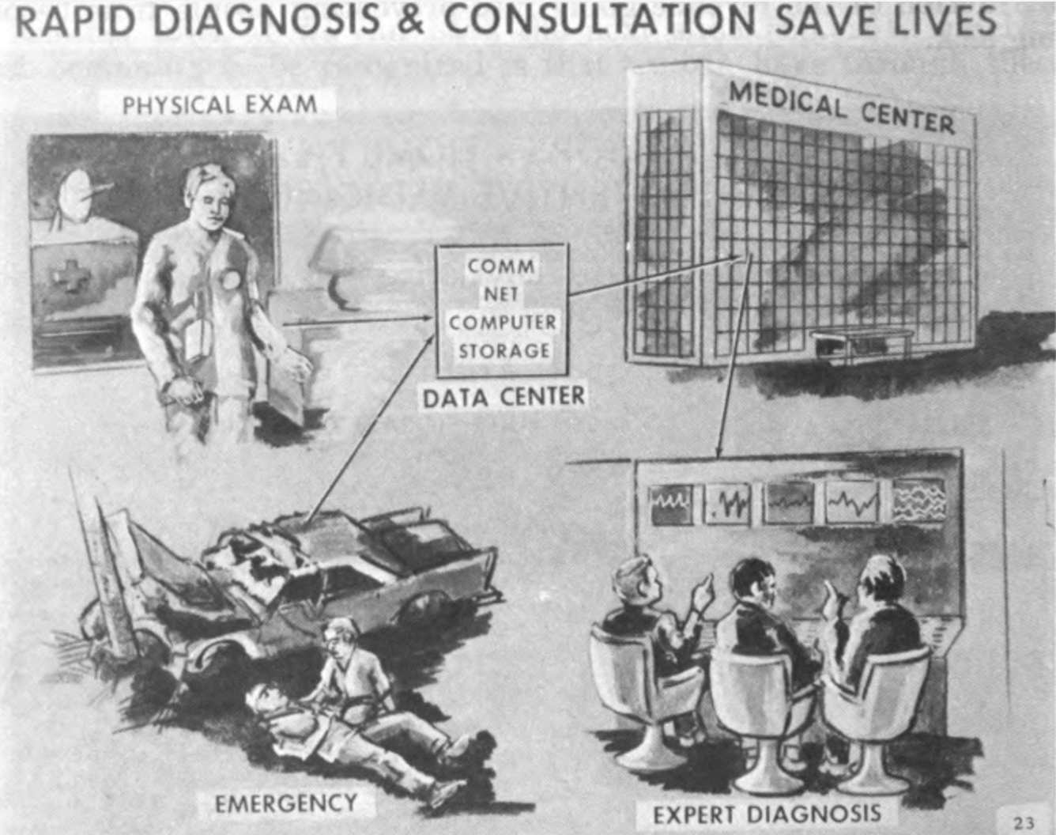

Slide 11
human
computer
data
high bandwidth

Slide 12
Notes:
Pyschological models of intelligence: Dual process models of Cognition: Daniel Kahneman System One and System Two. Steve Peters, Our Inner Chimp.

Slide 13
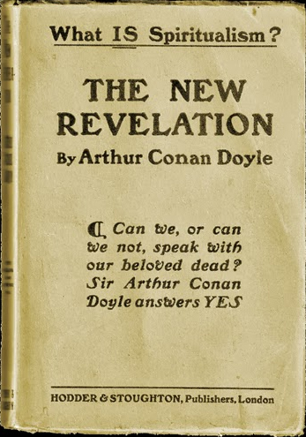
Notes:
Most people think of intelligence as Sherlock Holmes like deduction. But actually what we can achiee is closer to what a spiritualist might do when cold reading. Understanding of statistics, no rationalisation.

Slide 14
Outline of the DeepFace architecture. A front-end of a single convolution-pooling-convolution filtering on the rectified input, followed by three locally-connected layers and two fully-connected layers. Color illustrates feature maps produced at each layer. The net includes more than 120 million parameters, where more than 95% come from the local and fully connected layers.
Source: DeepFace
Notes:
DeepFace or a Calista Flockhart detector. 120 million parameters. A billion images for training.

Slide 15
$\text{g}\left(x\right)$
${\text{f}}_{1}(x)$
${\text{f}}_{2}(∙)$
${\text{f}}_{3}(∙)$
${\text{f}}_{4}(∙)$
${\text{f}}_{5}(∙)$
${\text{f}}_{6}(∙)$
${\text{f}}_{7}(∙)$
${\text{f}}_{8}(∙)$
${\text{f}}_{9}(∙)$
$\text{g}\left(x\right)={\text{f}}_{9}({\text{f}}_{8}({\text{f}}_{7}({\text{f}}_{6}(⋯))))$
Notes:
Mathematically we refer to this as composition of functions

Slide 16
$x$
$${\text{f}}_{1}\left(x_{1}\right)$$
$${\text{f}}_{2}\left({\text{f}}_{1}\left(x_{1}\right)\right)$$
$${\text{f}}_{3}\left({\text{f}}_{2}\left({\text{f}}_{1}\left(x_{1}\right)\right)\right)$$
$$y$$
Yes
No
Notes:
Seems complex but can be thought of as pinball.

Slide 17
$x$
$${\text{f}′}_{1}\left(x_{1}\right)$$
$${\text{f}′}_{2}\left({\text{f}′}_{1}\left(x_{1}\right)\right)$$
$${\text{f}′}_{3}\left({\text{f}′}_{2}\left({\text{f}′}_{1}\left(x_{1}\right)\right)\right)$$
$$y$$
Yes
No

Slide 18
Notes:
So in reality what we’ve created is much more akin to a mechanical elephant. One that takes inputs and feeds back responses.

Slide 19
Notes:
Or perhaps a better analogy is that we’ve created the turtle. System Zero in the Kahneman parlance. A large data aware organ that operates at a level below our subconscious.

Slide 20
!
?
?
!
Notes:
This can be disturbing to humans because we are used to a low bandwidth communication rate.

Slide 21
#
#!@?!
?
?
%@!!?
!

Slide 22
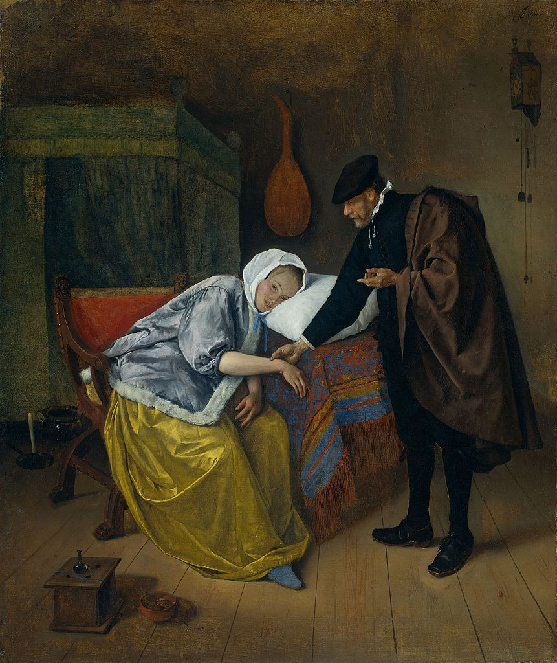
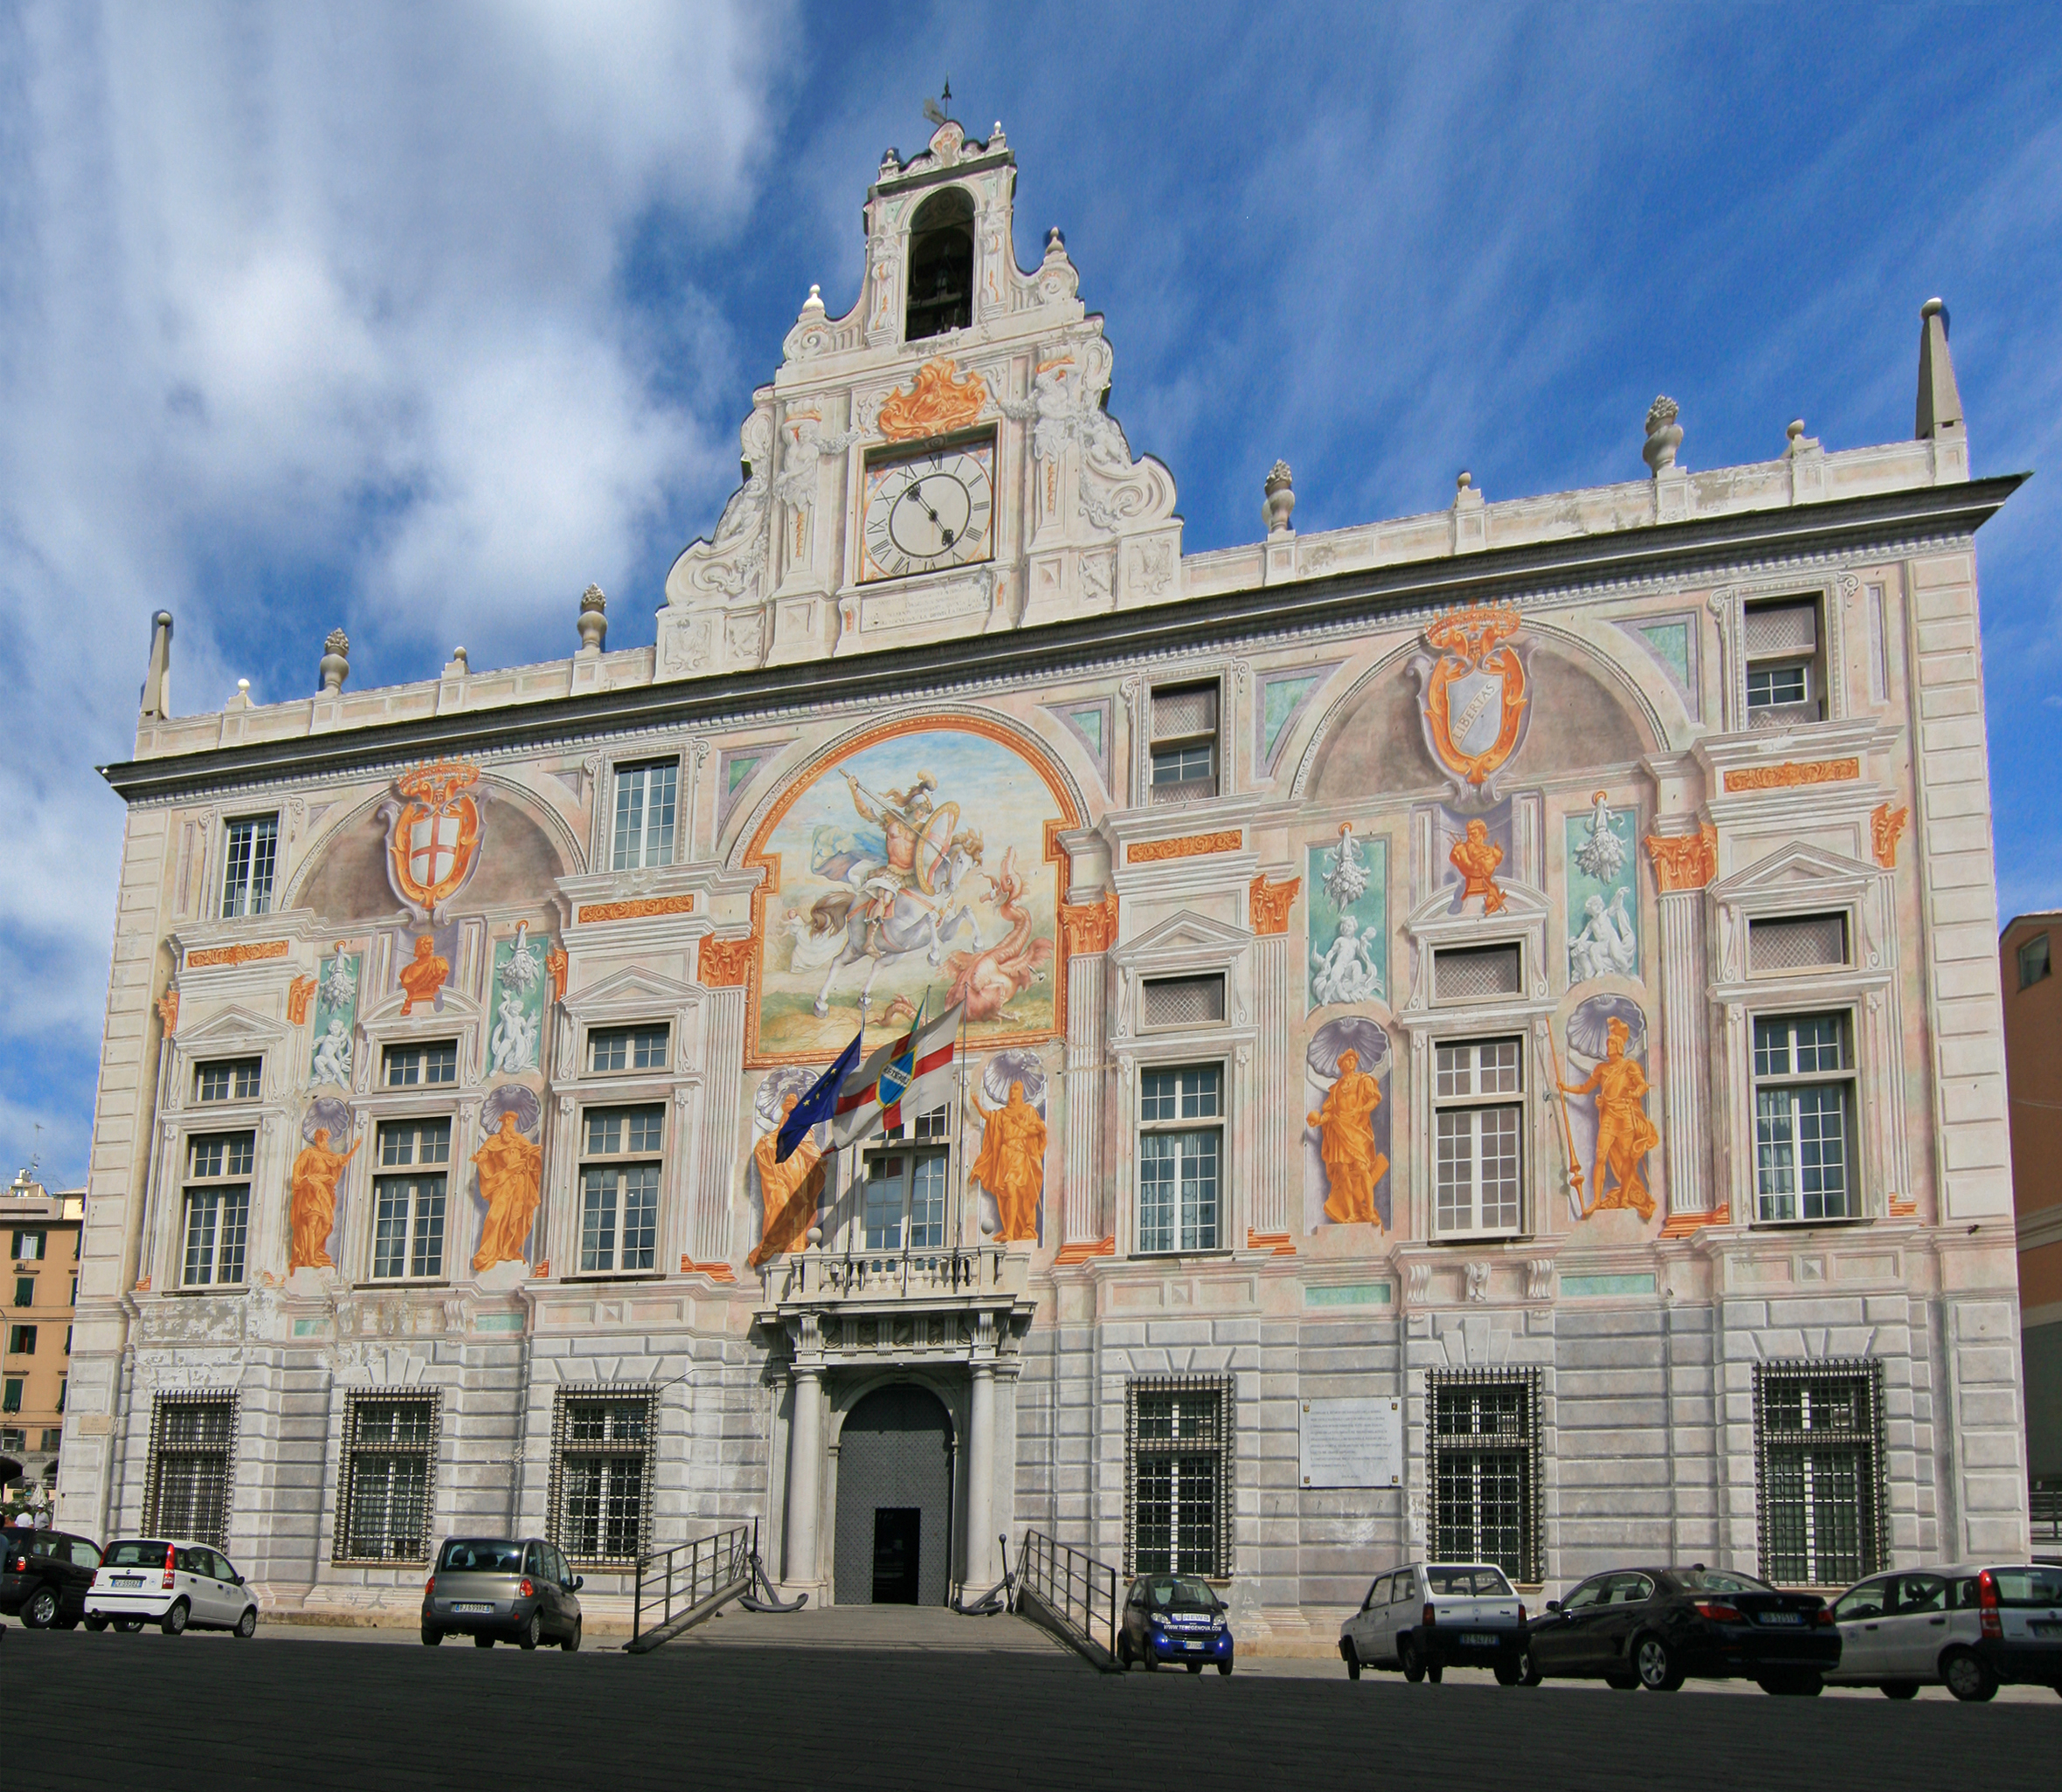
Notes:
We’ve developed institutions such as medicine and banks that ensure we understand when to trust and how to trust. Trust is critical to our mode of operation.

Slide 23
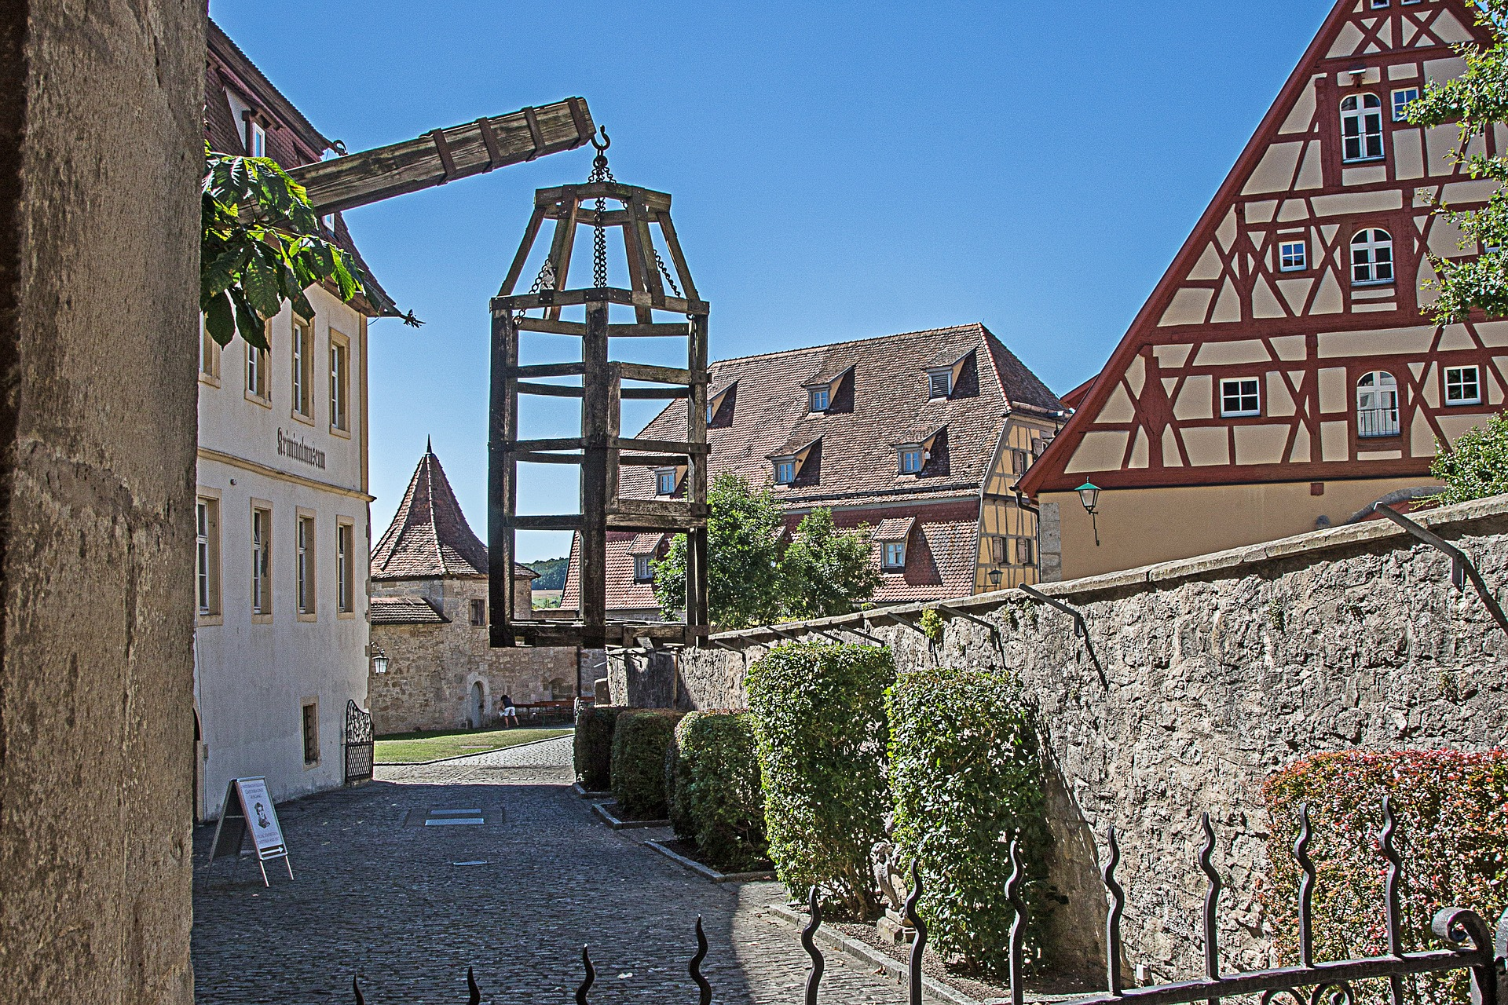
Notes:
Current approach to security is that we are either locked away or not, this does not map well to our notion of trust.

Slide 24
Notes:
It feels very much akin to the Medieval open field system. There are two ways in which our data I stored, either on our behalf by the “Lord of the Manor” or openly akin to the common land.

Slide 25
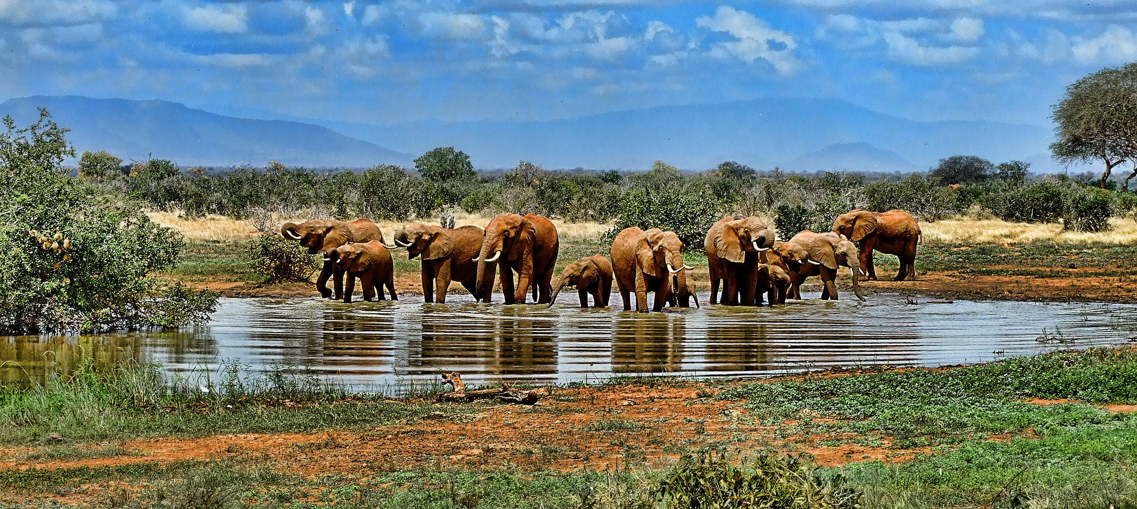
Notes:
If we could understand how to translate human notions of trust into the digital world then we would be better placed to operate with our traditional freedoms intact.

Slide 26
Thank you
Neil Lawrence
http://inverseprobability.com
@lawrennd
Notes:
Thank you.

