Slide 1
Update Title, Name of Presenter, Date and Venue
Post-Digital Transformation
Getting the Information Ecosystem Ready for the AI revolution
Professor Neil Lawrence
@lawrennd
Google Cloud Day

Slide 3
E S A R I N T U L
O M D P C F B V
H G J Q Z Y X K W

Slide 4
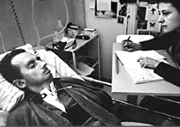
bits/minute
6
2000
billions
billions of
calculations/s
a billion
a billion
a thousand
5 trillion
years
15 billion
years
20
minutes
embodiment

Slide 5
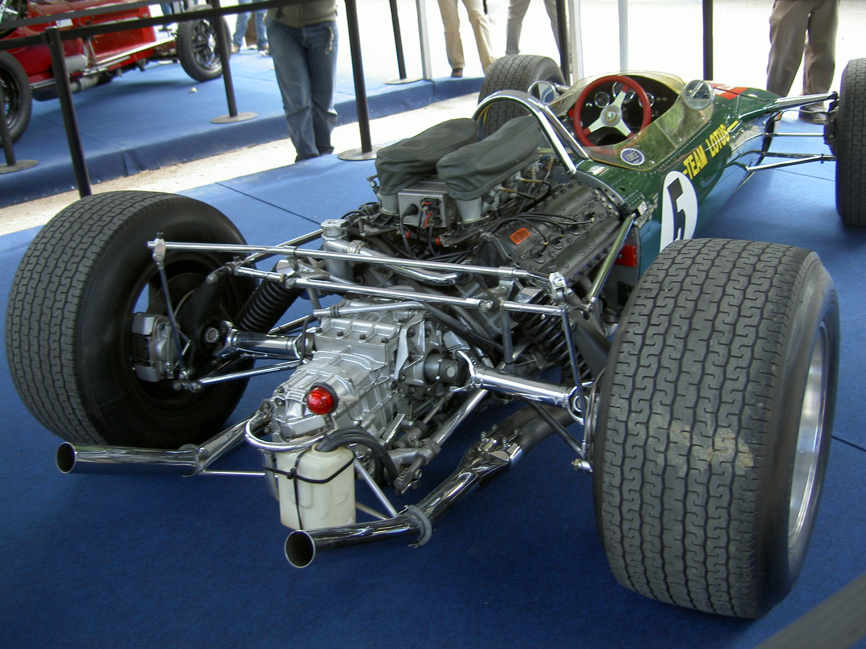
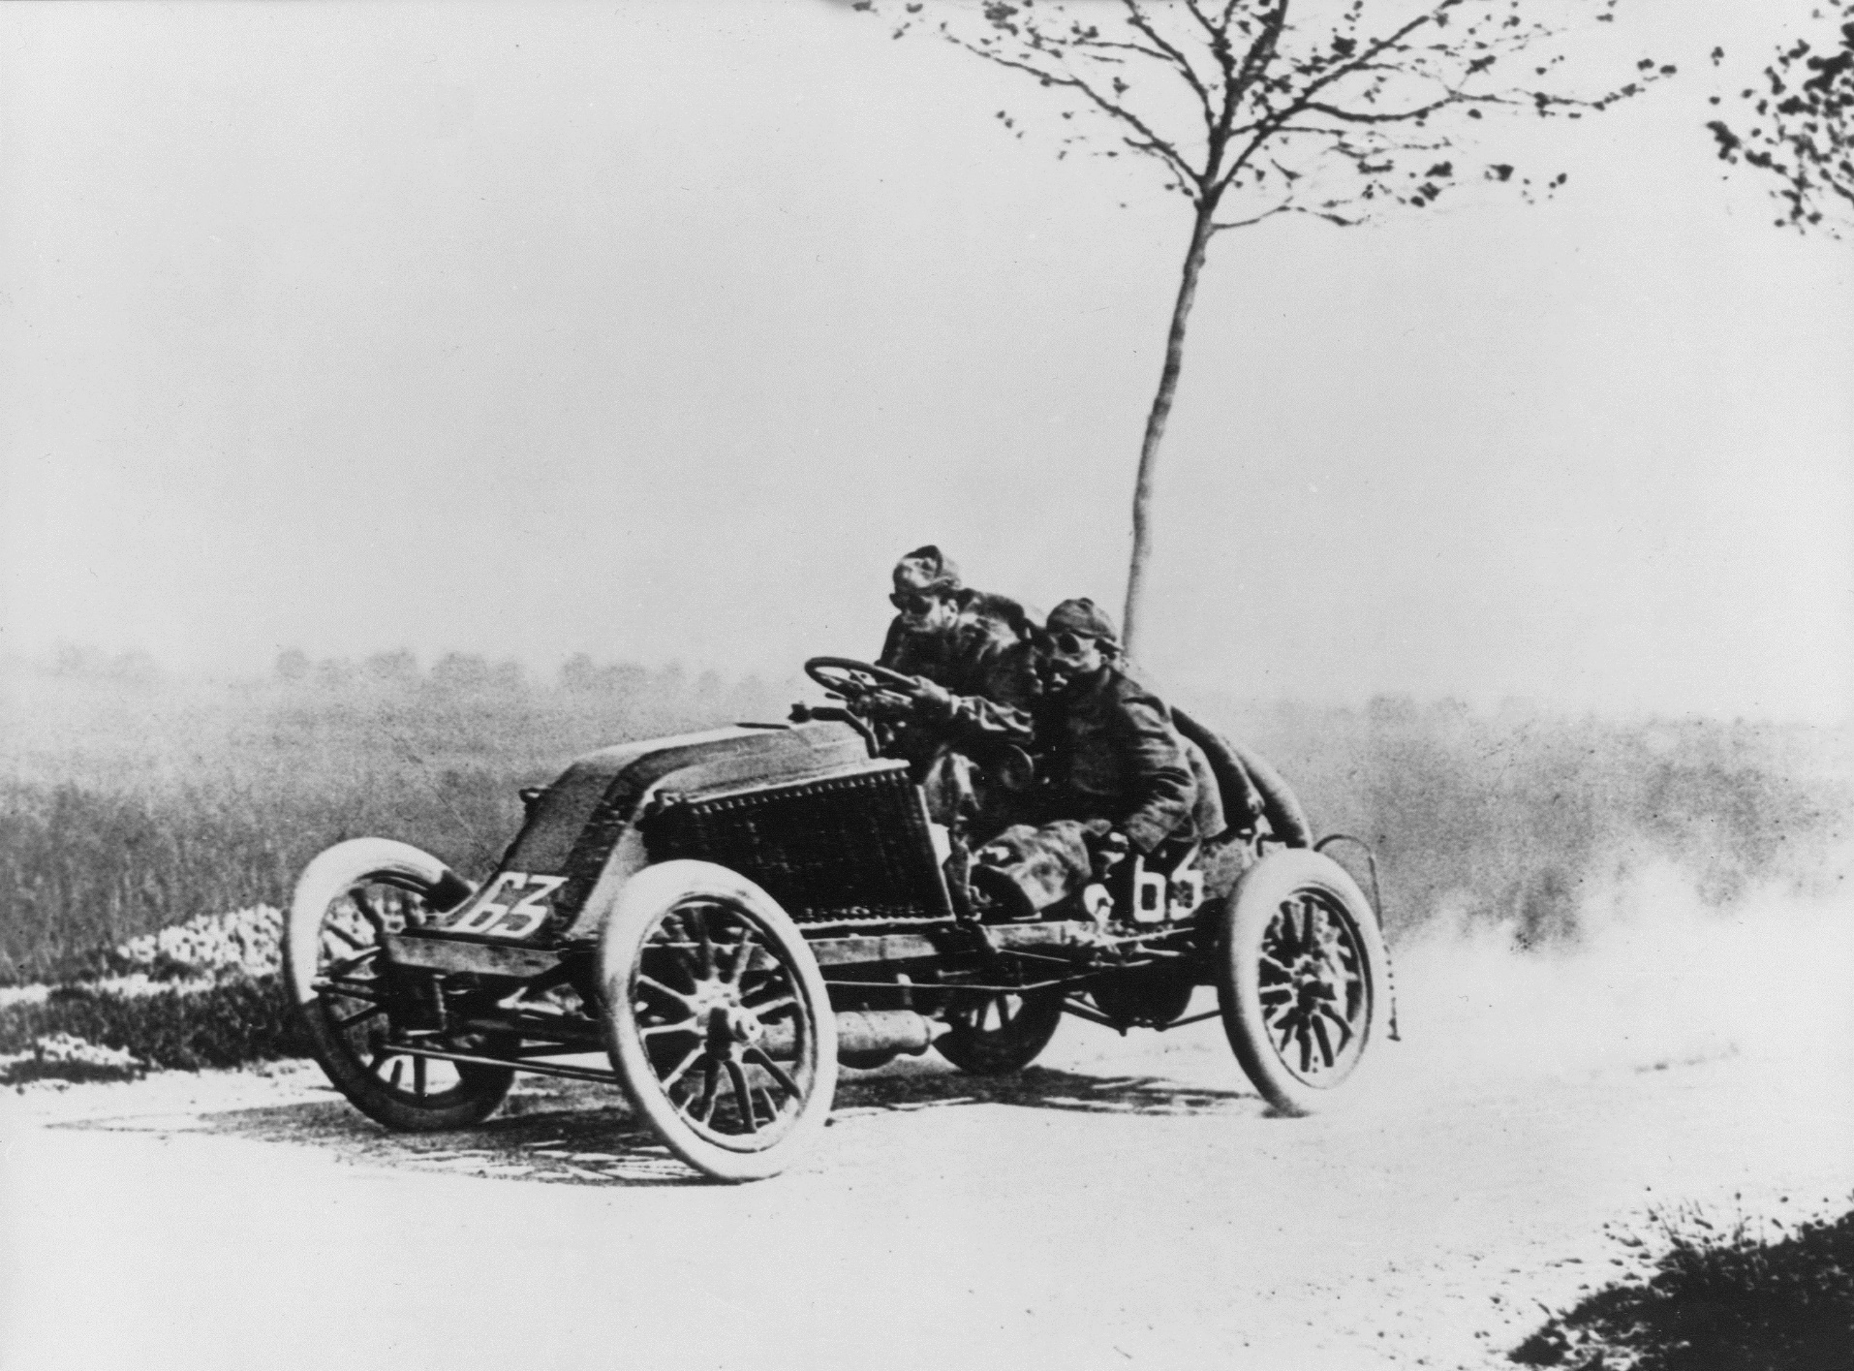
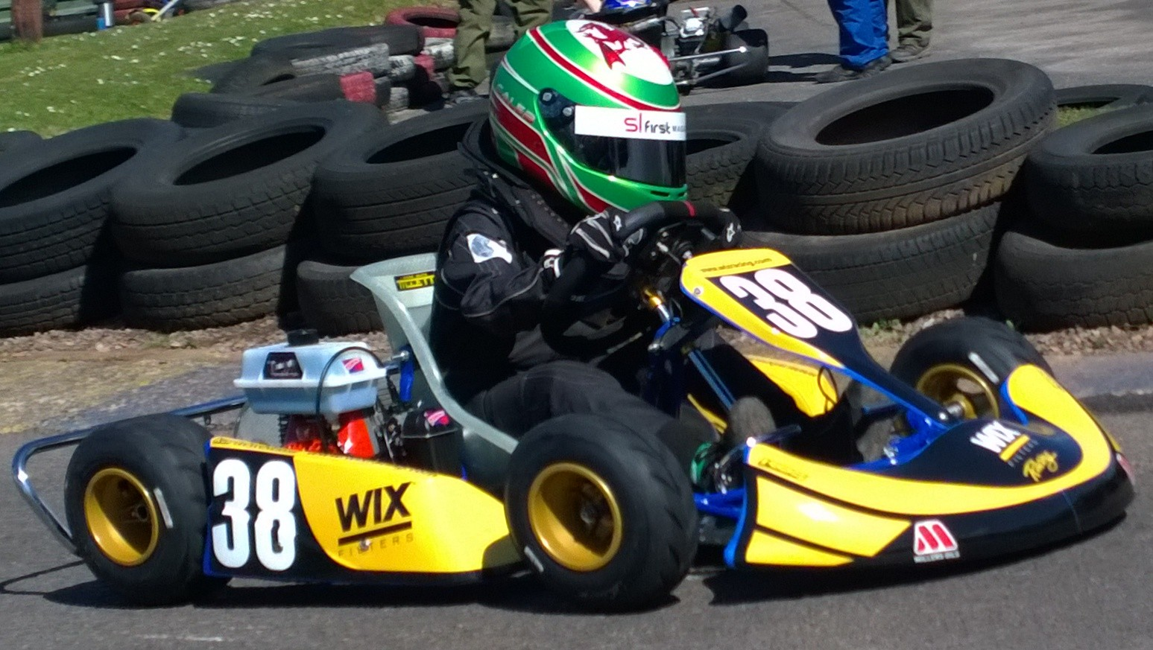
Notes:
Image sources: https://upload.wikimedia.org/wikipedia/commons/1/17/Lotus_49-2.JPG
https://upload.wikimedia.org/wikipedia/commons/f/fe/Marcel_Renault_1903.jpg
https://upload.wikimedia.org/wikipedia/en/b/b9/Caleb_McDuff_WIX_Silence_Racing_livery.jpg

Slide 6
?
!#@%&?
#
!
&
!
£*?$&!
&
?
#

Slide 7
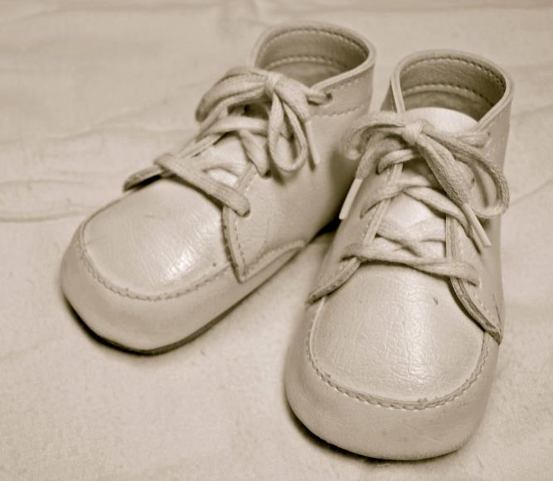
For Sale, Baby Shoes, Never Worn
Notes:
Slide image source: https://upload.wikimedia.org/wikipedia/commons/5/54/Classic_baby_shoes.jpg

Slide 8
No
!#@%&?
!
No

Slide 9
Evolved Relationship

Slide 10
There are three types of lies: lies, damned lies and statistics
??

Slide 11
There are three types of lies: lies, damned lies and statistics
Benjamin Disraeli

Slide 12
There are three types of lies: lies, damned lies and statistics
Benjamin Disraeli 1804-1881

Slide 13
There are three types of lies: lies, damned lies and ‘big data’
Neil Lawrence 1972-?

Slide 14
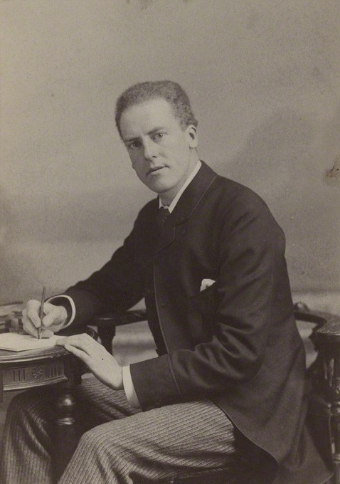
Mathematical Statistics

Slide 15
‘Mathematical Data Science’

Slide 16
Machine Learning

Slide 17
compute
data
+ model
prediction

Slide 18
What is Machine Learning?
$$compute$$
$$data+model→prediction$$
data : observations, could be actively or passively acquired (meta-data).
model : assumptions, based on previous experience (other data! transfer learning etc), or beliefs about the regularities of the universe. Inductive bias.
prediction : an action to be taken or a categorization or a quality score.
Royal Society Report
Machine Learning: Power and Promise of Computers that Learn by Example

Slide 19
What is Machine Learning?
$$compute$$
$$data+model→prediction$$
To combine data with a model need:
a prediction function $f(⋅)$ includes our beliefs about the regularities of the universe
an objective function $E(⋅)$ defines the cost of misprediction.

Slide 20
Post Digital Transformation

Slide 21
Artificial Intelligence and Data Science
AI aims to equip computers with human capabilities
Image understanding
Computer vision
Speech recognition
Natural language understanding
Machine translation

Slide 22
Supervised Learning for AI
Dominant approach today:
Generate large labelled data set from humans.
Use supervised learning to emulate that data.
E.g. ImageNet Russakovsky et al. (2015)
Significant advances due to deep learning
E.g. Alexa, Amazon Go

Slide 23
Data Science
Arises from happenstance data.
Differs from statistics in that the question comes after data collection.

Slide 24
Example: Supply Chain

Slide 25
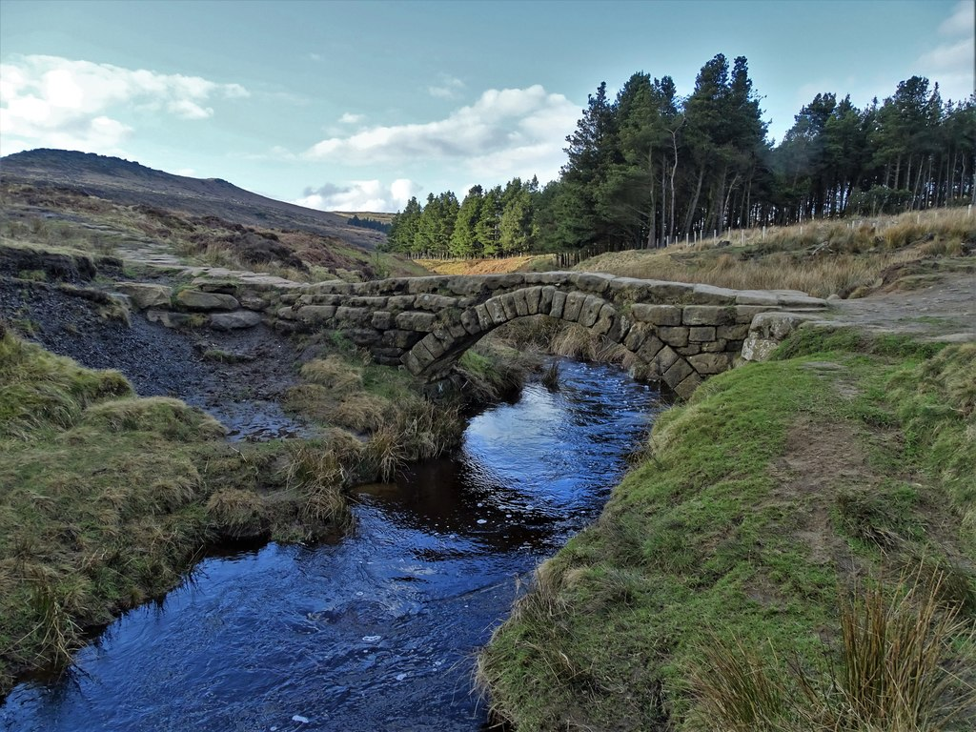

Slide 26
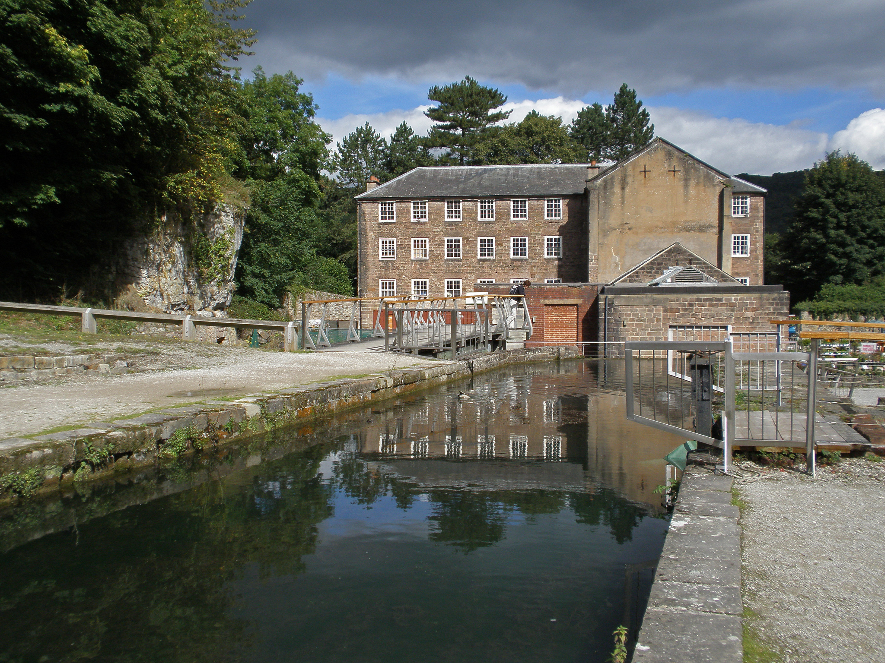

Slide 27
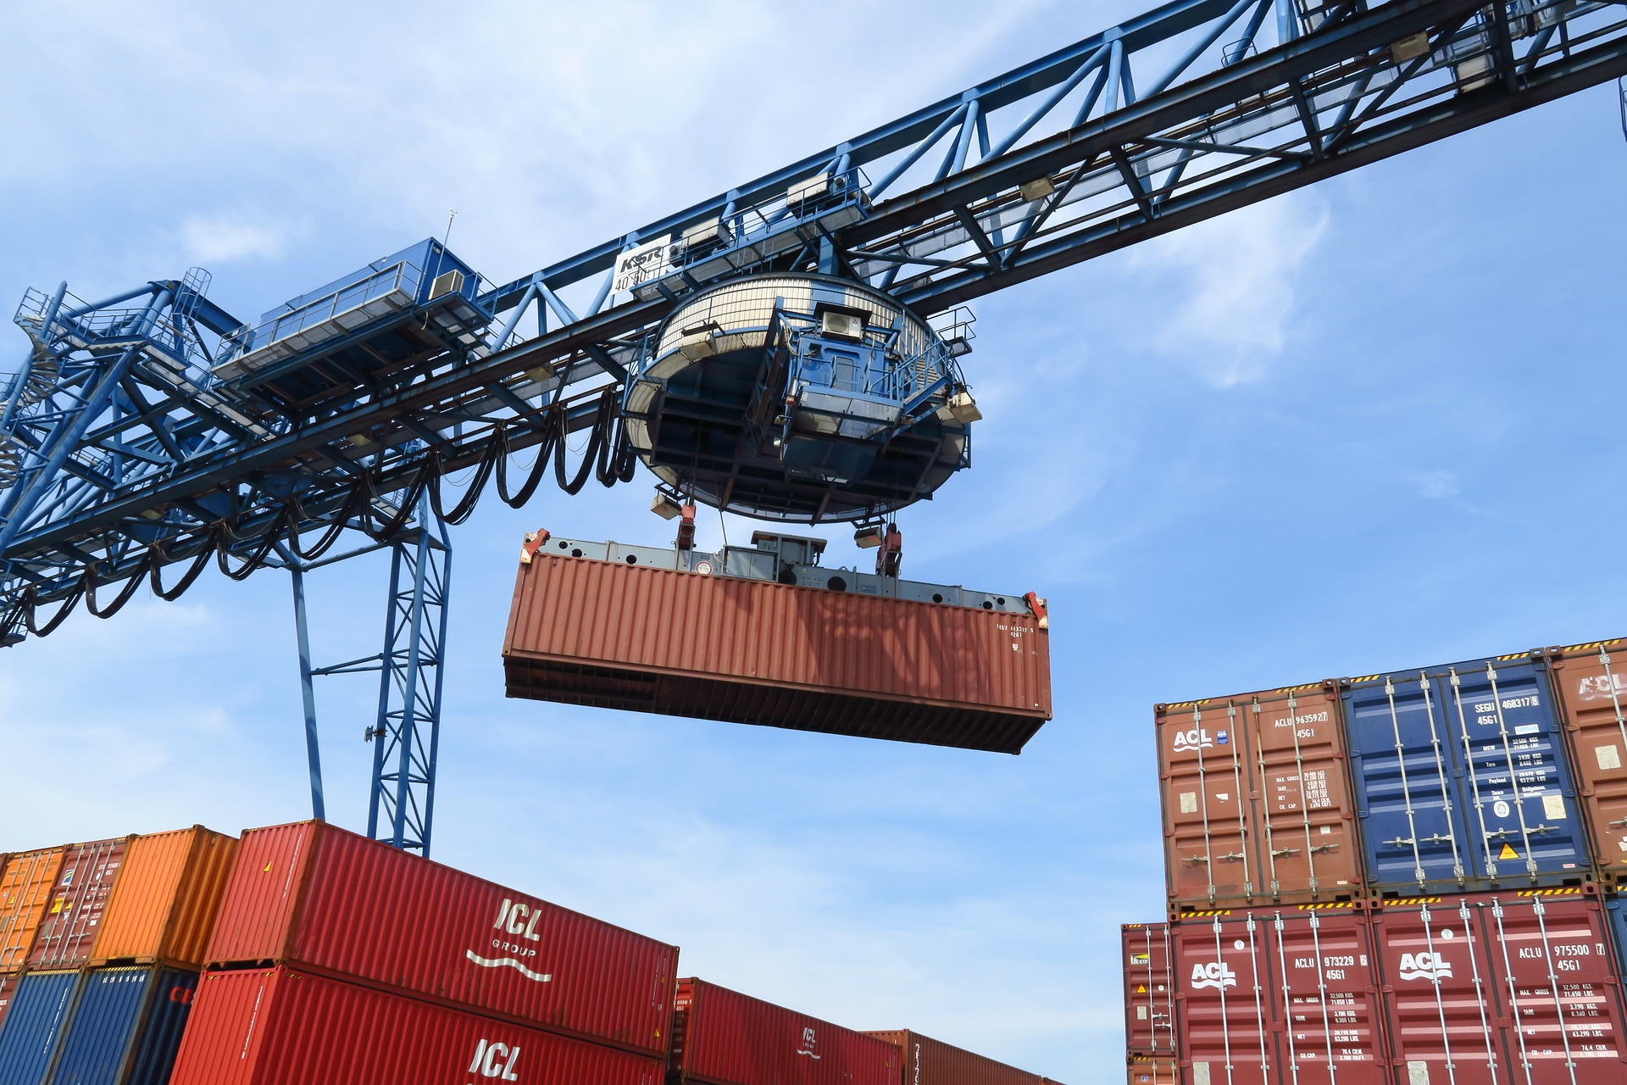

Slide 29
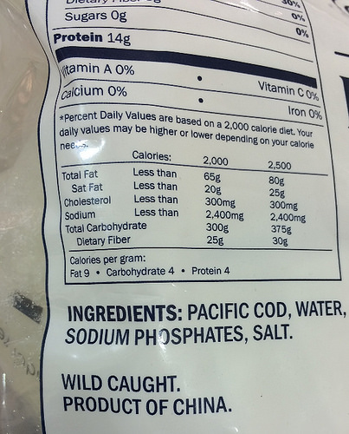

Slide 30
Machine Learning in Supply Chain
Supply chain:
Large automated decision-making network
Major Challenge:
We have a mechanistic understanding of supply chain.
Machine learning is a data driven technology.
Need to Explain Decisions

Slide 31
Challenges

Slide 32
Challenges
Data quality
Software systems
Corporate culture

Slide 33
Data Quality

Slide 34
You don’t have a data lake … it’s a data ocean
We require data-desalination before it can be consumed!

Slide 35
80/20 in Data Science
Anecdotally for a given challenge
80% of time is spent on data wrangling.
20% of time spent on modelling.
Many companies employ ML Engineers focussing on models not data.

Slide 36
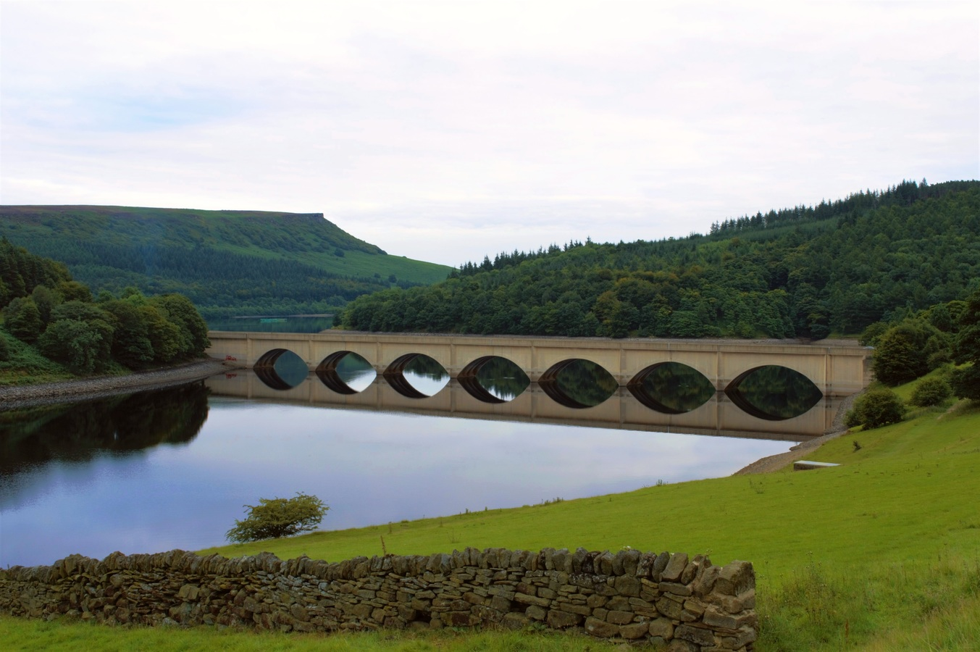

Slide 37
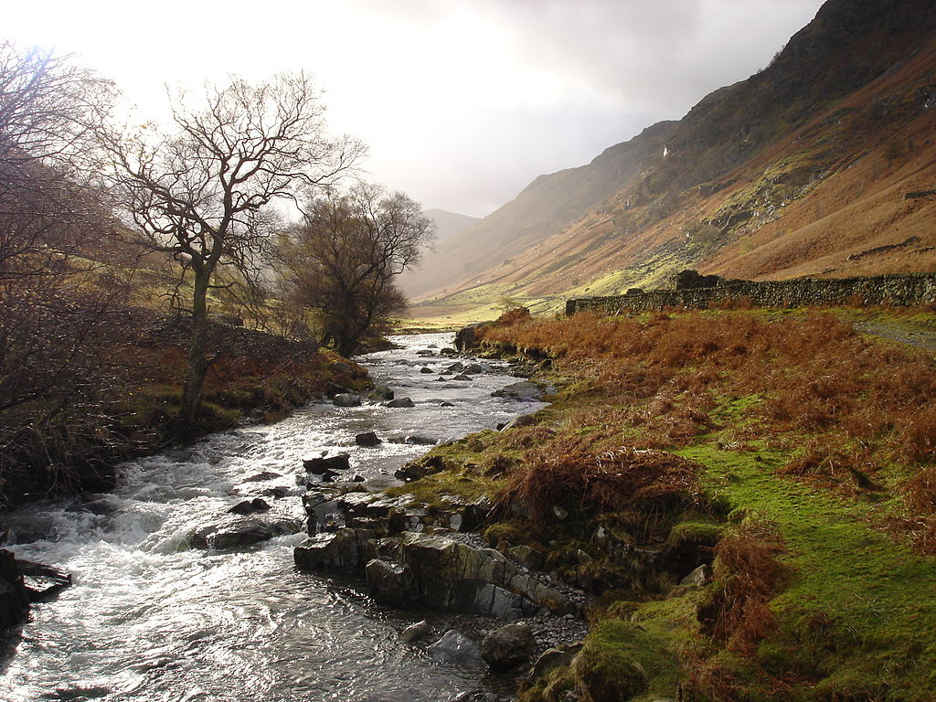

Slide 38
Value
How do we measure value in the data economy?
How do we encourage data workers: curation and management
Incentivization for sharing and production.
Quantifying the value in the contribution of each actor.

Slide 39
Credit Allocation
Direct work on data generates an enormous amount of ‘value’ in the data economy but this is unaccounted in the economy
Hard because data is difficult to ‘embody’
Value of shared data: Wellcome Trust 2010 Joint Statement

Slide 40
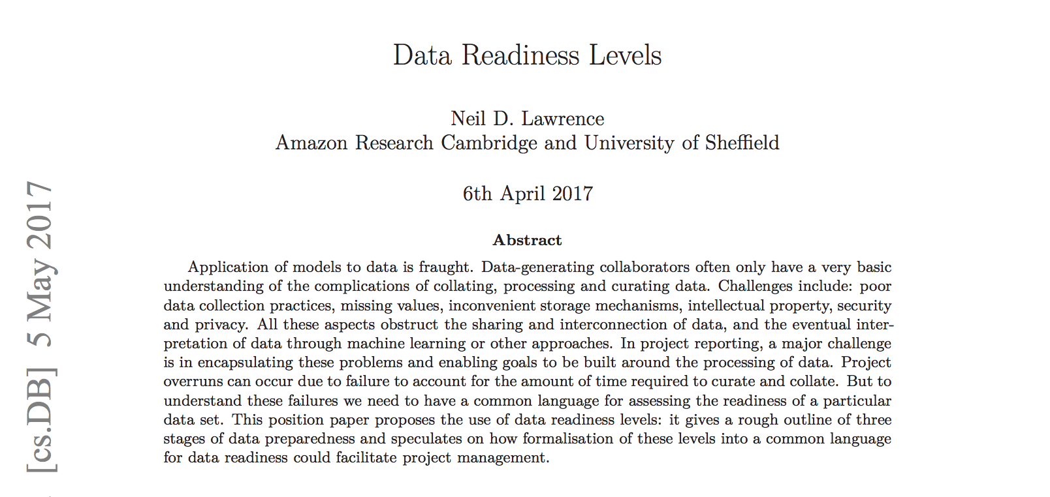
Data Readiness Levels
Data Readiness Levels (Lawrence, 2017)

Slide 41
Three Grades of Data Readiness
Grade C - accessibility
Transition: data becomes electronically available
Grade B - validity
Transition: pose a question to the data.
Grade A - usability

Slide 42
Accessibility: Grade C
hearsay data.
availability, is it being recorded?
privacy, legal or ethical issues
format: log-books, PDF …
limitations on access due to topology
At the end of Grade C data is ready to be electronically accessed

Slide 43
Validity: Grade B
faithfulness and representation.
visualizations.
exploratory data analysis
noise characterization.

Slide 44
Grade B Checks
Missing values.
Schema alignment, record linkage, data fusion
Examples:
Was a column or columns accidentally perturbed (e.g. through a sort operation that missed one or more columns)?
Was a gene name accidentally converted to a date?

Slide 45
Grade B Transition
At the end of Grade B, ready to define a task, or question
Compare with classical statistics:
Classically: question is first data comes later.
Today: data is first question comes later.

Slide 46
Data First
In a data first company teams own their data quality issues at least as far as grade B1.

Slide 47
Corporate Culture

Slide 48
The Tribal Mentality
$data+model$ is not new.
Dates back to Newton, Laplace, Gauss
Plethora of fields: E.g.
Operations Research
Control
Econometrics
Statistics
Machine learning
Data science
?
!#@%&?
&
£*?$&!
!
#

Slide 49
The Tribal Mentality
This can lead to confusion:
Different academic fields are:
Born in different eras
Driven by different motivations
Arrive at different solutions

Slide 50
Tribalism Can be Good
Allows for consensus on best practice.
Shared set of goals
Ease of commiunication
Rapid deployment of robust solutions

Slide 51
Professional Tribes
This is the nature of professions
lawyers
medics
doctors
engineers
accountants

Slide 52
Different Views
$$data+model$$
For OR, control, stats etc.
More things unite us rather than divide us.

Slide 53
We’re no longer hunter gatherers …
The automation challenges we face require
all of our best ideas.
rethinking what $data+model$ means
rapid deployment and continuous monitoring
This is the era of data science

Slide 54
Discomfort and Disconformation
Talking across field boundaries is critical.
It helps us disconfirm our beliefs.
It’s not comfortable, but it’s vital.

Slide 55
Five AI Myths
AI will be the first wave of automation that adapts to us.
Hearsay data has significant value.
The big tech companies have the landscape all ‘sewn up’
‘data scientists’ will come and solve all problems.
The normal rules of business don’t apply to AI.

Slide 56
Mythbusting
Area of good data:
Finance

Slide 57
Criteria for Success
Executive sponsorship (CEO).
Technical Expertise (Open minded expert).
Financial buy in (CFO).
Assimilated knowledge (CTO).

Slide 58
Normal Organisational Rules Apply
AI is not magical pixie dust
Standard organizational instincts apply
Disruption requires agile thinking.
Don’t be the Grand Old Duke of York
Be Special Forces

Slide 59
Thanks!
podcast: The Talking Machines
newspaper: Guardian Profile Page
Blog posts:
What is Machine Learning?
System Zero
Lies, Damned Lies and Big Data
Data Readiness Levels

Slide 60
References
Russakovsky, O., Deng, J., Su, H., Krause, J., Satheesh, S., Ma, S., Huang, Z., Karpathy, A., Khosla, A., Bernstein, M., Berg, A.C., Fei-Fei, L., 2015. ImageNet Large Scale Visual Recognition Challenge. International Journal of Computer Vision (IJCV) 115, 211–252. https://doi.org/10.1007/s11263-015-0816-y

